Slide 1
“Organizations should invest in inclusion and addressing bias because it is crucial to hire and maintain a diverse workforce – not only to have diversity within an organization but to leverage that diversity to help others who are oppressed.” Yonayda Rodas YWCA Advocacy Committee Senior at San Rafael High School

Slide 2
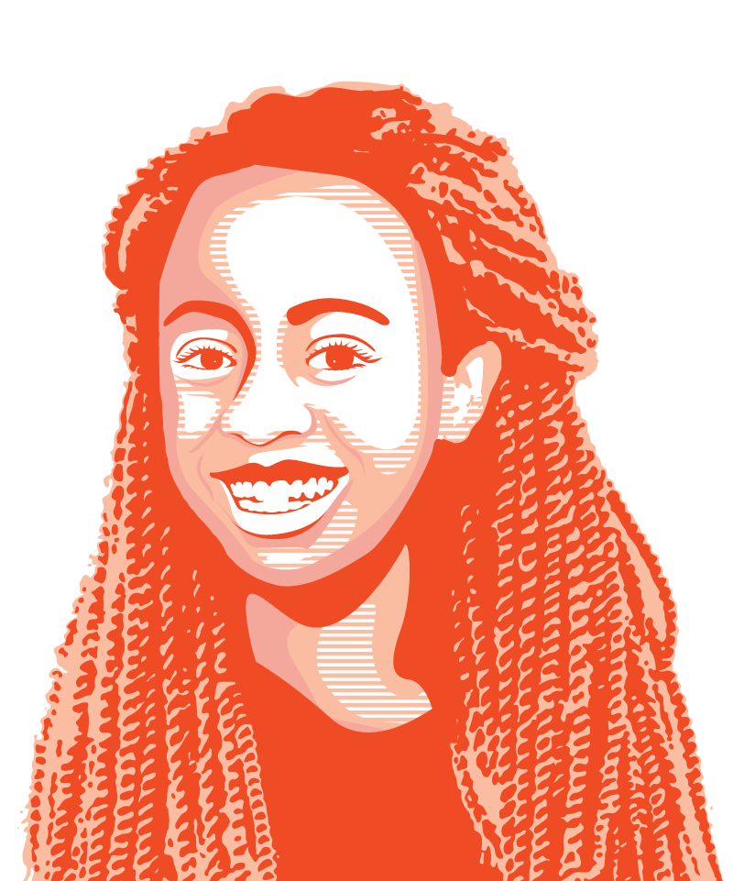
1. Know who you are.
Notes:
First time you were aware of your race.

Slide 3
Culture
“The way we do things around here.”
Arts Tradition Food
Dress Holidays Games
Music Language Festivals
Beliefs
Values
Expectations
Social roles
Norms
Priorities
Assumptions Worldviews
Behaviors
Thought patterns
Notes:
Multicultural events to celebrate others, own culture, impose on others.
Who are we now?
Might have strong, exclusive expectations without realizing it AND might be more diverse than we realize – bringing full selves to table

Slide 4
2. Ask what kind of diversity and why?

Slide 5
Diversity
A range of different things. Variety.
Notes:
“Diversity” =/= “Race”
What are some dimensions of diversity?
Age, race, religion, language, ability, gender, sexual orientation, national origin, citizenship status, language, family status, class
It’s almost impossible to become “more diverse” w/o identifying what diversity matters & why
This does not mean be all things to all people. It means be aware of the limitations of your work and know you cannot be all things to all people. Decide who you will be for and how and work towards expanding that.
Never a monolith. Each of these groups has variety within them.
People can see through trends and won’t trust it
It will be hard and you need ground to come back to

Slide 6
Structural Oppression
Bias or prejudice plus institutional or structural policies, practices, and power
Notes:
(3)
https://www.youtube.com/watch?v=dw_mRaIHb-M

Slide 7
Where do we start?
Personal
Local
State
Federal
Cultural

Slide 8
3. Know – and expand – what you’re ready to change.

Slide 9
Personal
Notes:
Be attentive to how you show up. Learn, listen, grow.

Slide 10
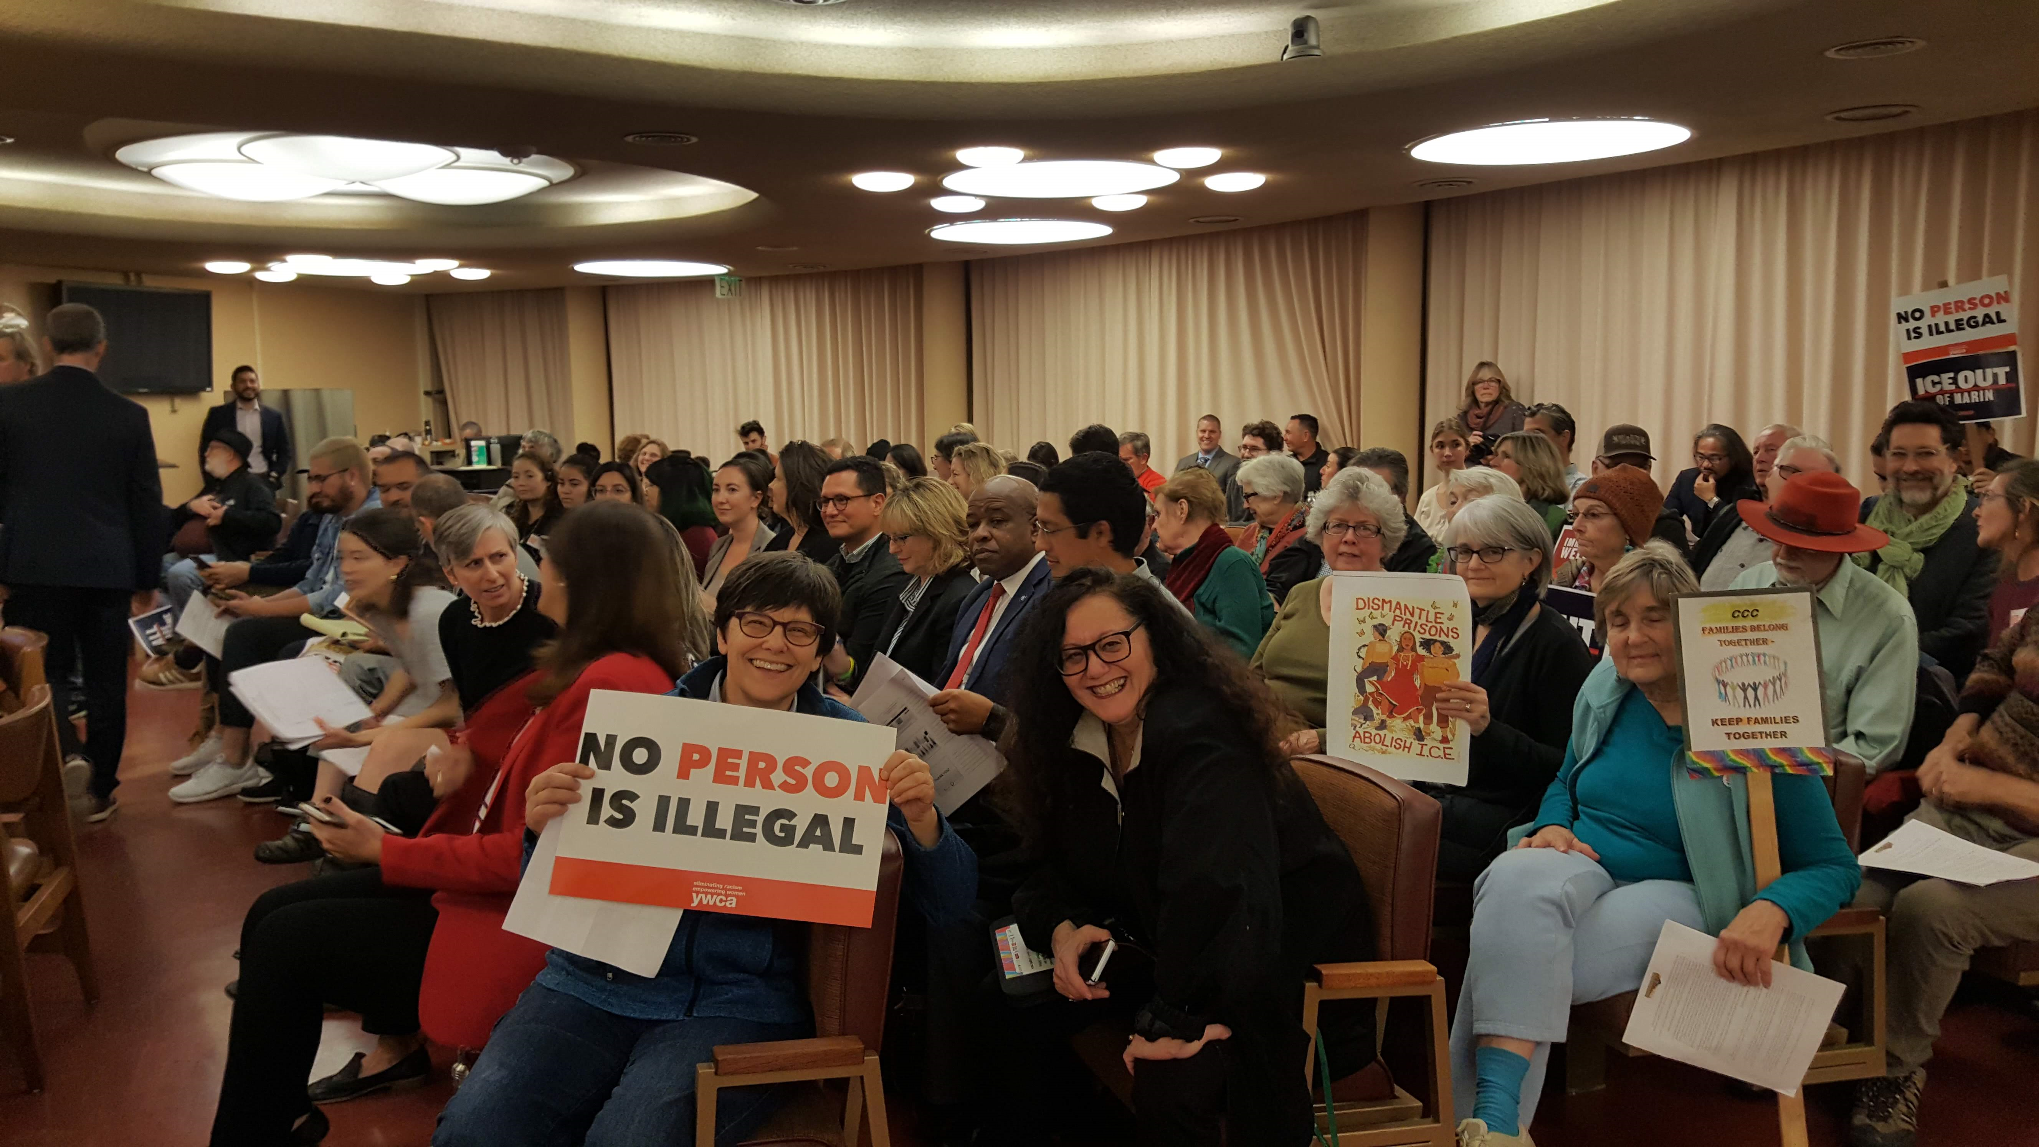
Local
Notes:
Public education, implementation, and enforcement happen locally. Pay attention and build relationships.

Slide 11
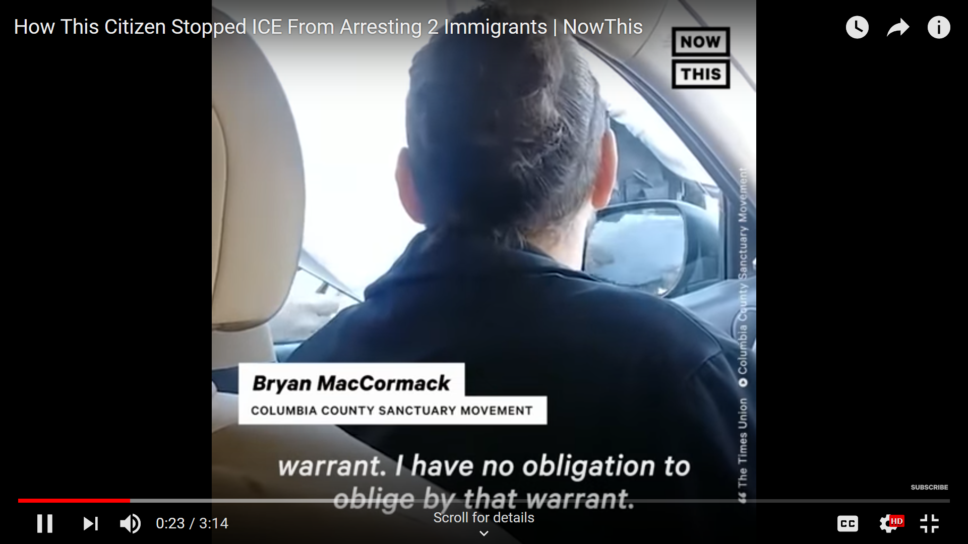
Notes:
https://www.youtube.com/watch?v=8z7HkHVP6oU

Slide 12
AB 668
State
Notes:
This is where people power starts to matter. Follow leadership from impacted people (CIYJA, CIPC, Domestic Workers Alliance).

Slide 13
DREAM & Promise Act (HR 6)
Federal
Notes:
This is where CA can lead. Make sure your reps hear from you before and after. Gratitude matters!

Slide 14
“The way we do things around here.”
Arts Tradition Food
Dress Holidays Games
Music Language Festivals
Beliefs
Values
Expectations
Social roles
Norms
Priorities
Assumptions Worldviews
Behaviors
Thought patterns
Cultural
Notes:
Cultural principles undergird everything we do. Make culture shift the north star of all our work.

Slide 15
Bridges difference
Deeply comprehends difference
De-emphasizes difference
Judges difference
Misses difference

Slide 16
Steps for Success
Know who you are.
Ask what kind of diversity and why it matters for you.
Know – and expand – what you’re ready to change.
Notes:
A way of life among a select group of people
What is it? Where do we get it? Overlapping and unique, given and chosen

Slide 17
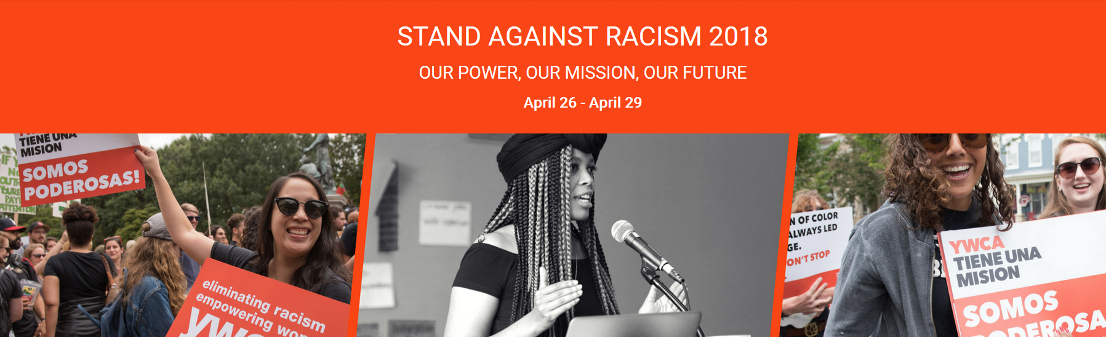
Advocate: tinyurl.com/ywcaAB668
Follow: @YWCASFMarin, @ciyja, @iceoutofca
Learn: www.ywcasf-marin.org
Connect: Laura Eberly | laura@ywcasf-marin.org
Thank you!

Slide 18
#1 Advocacy Skill: Listening
1. Person A speak for 2 minutes about something you learned today.
Person B actively ignore her.
Switch roles.
Report back. How does this feel?
________________________________________________________
4. Person A speaks for 2 minutes about the same subject.
Person B listens deeply.
Try to hold questions, advice, and reactions until later.
Switch roles.
Report back. How does this feel?

